Slide 1






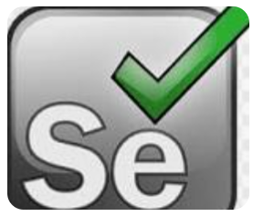


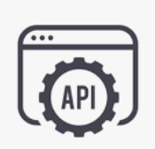
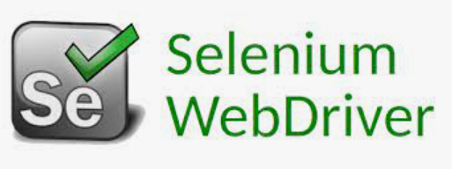


Selenium Framework(Both Web/API applications
Config files
Logs
Automation
Developer
PPPPP
Generic & Business
Utilities
Git & Jenkins Integration
Pages
Actors
Selenium & BDD Framework
Spark report
Definitions
Runners
features
Data Sheets

